Slide 1
Quick and dirty development of static analyses with LiSA
Luca Negrini, Pietro Ferrara
Ca’ Foscari University of Venice
luca.negrini@unive.it

Slide 2
A Library for Static Analysis
LiSA is a Java library for building static analyzers based on the Abstract Interpretation theory
LiSA provides a unique fixpoint algorithm operating on a language-independent intermediate representation
generic w.r.t. the analyses that can be performed
generic w.r.t. the languages that can be analyzed

Slide 3
A bit of history…
Back in 2020, where it all began:
Just started a PhD at Ca’ Foscari
Working at JuliaSoft on Julia
Background: taint analysis, Java/C#
Assistant Professor at Ca’ Foscari
Worked on Julia, Sample, Checkmate, …
Background: C-like languages
Research Fellow at Ca’ Foscari
Developer of μJS in Verona
Background: string analysis, JavaScript

Slide 4
… and some motivations
When we met, we did not have an analyzer to work with
We aimed at a tool that was good for our research:
on different properties
on different programming languages
easy to build upon
… but also good for our teaching:
with short pickup time
implementations close to their formal definition
And what we found in the literature was not what we wanted

Slide 5
From motivations to requirements
different properties
different languages
Generic analysis engine
Pluggable analysis implementations
No fixed input representation
No semantic assumptions
easy to build upon, short pickup time, implementation ≈ definition
Modular infrastructure
Reusable analysis components
Single responsibility of analysis components

Slide 6
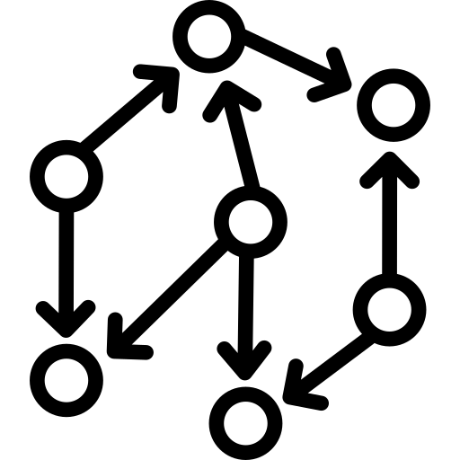
LiSA is a library
Full analyzer
configuration parameters
components selection
plug-in new components
source
code
inputs
warnings
and outputs
generic analysis engine
pre-developed components

Slide 7
Today’s plan
Understand the high-level architecture of LiSA
Call resolution and evaluation
Statement rewriting
Memory abstraction
Value abstraction
A first value analysis: the domain of Signs
A simple relational analysis: the domain of Upper bounds
Products and relational analyses: the domain of Pentagons
Information flow: the Taint analysis
Questions make me happy: please ask at any time!

Slide 8
Today’s plan
Understand the high-level architecture of LiSA
Call resolution and evaluation
Statement rewriting
Memory abstraction
Value abstraction
A first value analysis: the domain of Signs
A simple relational analysis: the domain of Upper bounds
Products and relational analyses: the domain of Pentagons
Information flow: the Taint analysis

Slide 9
LiSA’s structure
Frontends are parsers that:
provide the definition of the language semantics
provide the semantics of each instruction
compile the source code to a LiSA program
P_{i}
Frontend_{i}
Why CFGs?
to get rid of control flow!
easy to compute fixpoints over graphs
can be produced in isolation by each frontend
easily extensible…
CFGs
language-dependent

Slide 10
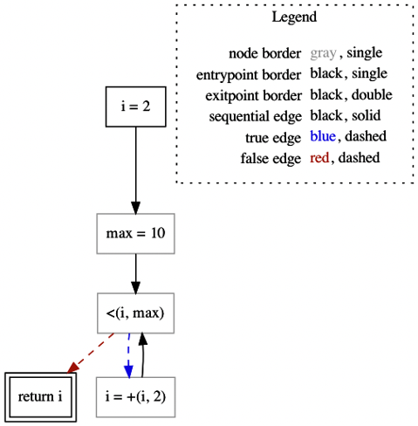
CFGs
int i = 2;
int max = 10;
while (i < max)
i = i + 2;
return i;
Nodes are instances of the Statement class
Edges are instances of the Edge class
LiSA does not fix a semantics for any statement, but lets users define them (more details later)

Slide 11
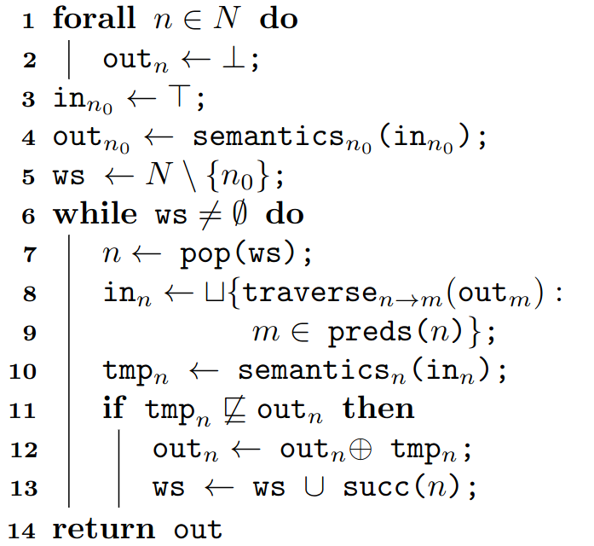
Computing fixpoints over CFGs
LiSA implements the classical worklist-based fixpoint
Delegating to Statement.semantics()
Using Edge.traverse()
Applying lub or widening

Slide 12
LiSA’s structure
configuration,
components
P_{i}
LiSA
?
?
Program-wide
fixpoint
?
?
Call resolution
and evaluation
Frontend_{i}
Statement
semantics
?
Value
Abstraction
?
Memory
Abstraction
?
CFGs
Recall that our requirements are:
Modular infrastructure
Reusable analysis components
Single responsibility of analysis components
language-dependent
CFG fixpoint

Slide 13
Today’s plan
Understand the high-level architecture of LiSA
Call resolution and evaluation
Statement rewriting
Memory abstraction
Value abstraction
A first value analysis: the domain of Signs
A simple relational analysis: the domain of Upper bounds
Products and relational analyses: the domain of Pentagons
Information flow: the Taint analysis

Slide 14
The program-wide fixpoint
This happens inside the CFG fixpoint! We do not want this logic to flow over there
select the CFGs to start the analysis from
run a fixpoint over them
are calls
in the CFG?
yes
access another CFG’s result
no
find other CFGs to analyze
access the result from a previous fixpoint

Slide 15
The Interprocedural Analysis
fixpoint logic
semantics()
Interprocedural
Analysis
CFG fixpoint
Non-calling statement
abstract state
getTargetsOf(c)
getResultOf(this)
semantics()
possible targets
abstract state
abstract state
Logic can be:
Start from main and follow calls
Consider CFGs in isolation
…
Call Graph can use:
Runtime types of parameters
Types compatible with the signature
…
Statement semantics does not need to know how the global fixpoint is computed!
The whole process is independent on what analysis we are running!
And the remaining part of the analysis can ignore calls!
Call Graph
Calling statement
configurable

Slide 16
LiSA’s structure
configuration,
components
P_{i}
LiSA
Frontend_{i}
CFG fixpoint
?
Value
Abstraction
Interprocedural
Analysis
CFGs
?
?
Memory
Abstraction
Call Graph
language-dependent
configurable
?
Statement semantics
?

Slide 17
Today’s plan
Understand the high-level architecture of LiSA
Call resolution and evaluation
Statement rewriting
Memory abstraction
Value abstraction
A first value analysis: the domain of Signs
A simple relational analysis: the domain of Upper bounds
Products and relational analyses: the domain of Pentagons
Information flow: the Taint analysis

Slide 18
Syntax vs Semantics
The Statement class defines a semantics() function that is invoked by the fixpoint
This is where we specify what a syntactic construct means
E.g., a call’s semantics() delegates to the Interprocedural Analysis
We want to specify semantics generically
The same semantics should apply for all possible analyses
But syntax can be complex:
Java’s a + b can be a numeric sum or a string concatenation
Python’s [f(x) for x in dict.values()] expands to a loop

Slide 19
Syntax vs Semantics
Our solution: break down Statements into SymbolicExpressions
From complex syntax to atomic operations with precise semantics
Each Statement can become a sequence of smaller operations
The rewriting happens dynamically, and can exploit the analysis
Types, possible values, …
SymbolicExpressions are extensible
We provide some common one, but users can define more
Analyses only have to model these expressions, ignoring the syntax behind them!

Slide 20
Examples (pseudocode)
Plus.semantics(): // left + right
if type(left) is string or type(right) is string:
return domain.eval(new BinaryExpression(“cat”, left, right))
else:
return domain.eval(new BinaryExpression(“+”, left, right))
Conditional.semantics(): // condition ? ifTrue : ifFalse
sat = domain.isSatisfied(condition)
tt = ifTrue.semantics()
ff = ifFalse.semantics()
return sat.isTrue() ? tt : (sat.isFalse() ? ff : tt ⊔ ff)
PreIncrement.semantics(): // ++var
add = new BinaryExpression(“+”, var, new Const(1))
d1 = domain.assign(var, add)
return d1.eval(var)

Slide 21
LiSA’s structure
configuration,
components
P_{i}
LiSA
Frontend_{i}
CFG fixpoint
?
Value
Abstraction
Interprocedural
Analysis
CFGs
?
?
Memory
Abstraction
Call Graph
language-dependent
configurable
Statement semantics

Slide 22
Today’s plan
Understand the high-level architecture of LiSA
Call resolution and evaluation
Statement rewriting
Memory abstraction
Value abstraction
A first value analysis: the domain of Signs
A simple relational analysis: the domain of Upper bounds
Products and relational analyses: the domain of Pentagons
Information flow: the Taint analysis

Slide 23
Combining values and memory
While calls are “easy” to abstract away, dynamic memory (stack or heap) and computed values are strongly coupled
Values are moved from variables to dynamic memory continuously
Despite this, we still want to keep management of the two separate
For reusability
To reduce the complexity of the implementations
To allow newcomers to write only the analyses they need

Slide 24
What happens concretely?
Every memory-dealing instruction “refers” to an address in memory
We can see each possible address as a separate variable
class Foo {
int f, g;
}
x = new Foo();
x.f = 5;
x.g = 7;
expression | address | variable
new Foo() | 0x10010… | L₁
x.f | 0x11011… | L_{1.1}
x.g | 0x01010… | L_{1.2}
class Foo {
int f, g;
}
x = L₁;
L_{1.1} = 5;
L_{1.2} = 7;
What if we treat addresses as variables?

Slide 25
The Abstract State
The Heap Domain tracks the structure of the dynamic memory
new allocations
pointer aliasing
…
Abstract State
Heap Domain
expr
rewrite
The Heap Domain rewrites memory-related expressions to their symbolic variables
Value Domain
The Value Domain only “sees” expressions with variables and constants!
configurable

Slide 26
The Abstract State
Abstract State
 |  |  | precision
expression | variable | low | medium | high
new Foo() | L₁ | L | L₁ | L₁
x.f | L_{1.1} | L | L₁ | L_{1.1}
x.g | L_{1.2} | L | L₁ | L_{1.2}
Heap Domain
x.f = 5
x.g = 7
rewrite
L₁ = 7
L_{1.1} = 5
L_{1.2} = 7
L₁ = 5
Value Domain
L_{1.1} and L_{1.2} are assigned once each, so we are more precise without changing the Value Domain!
configurable
L₁ is assigned twice, so we lost precision!
Can we do better?

Slide 27
LiSA’s structure
configuration,
components
warnings,
analysis dumps
P_{i}
LiSA
Checks
Frontend_{i}
CFG fixpoint
Abstract state
Interprocedural
Analysis
CFGs
Heap
Domain
Call Graph
Value
Domain
language-dependent
configurable
Statement semantics

Slide 28
Questions?

Slide 29
Today’s plan
Understand the high-level architecture of LiSA
Call resolution and evaluation
Statement rewriting
Memory abstraction
Value abstraction
A first value analysis: the domain of Signs
A simple relational analysis: the domain of Upper bounds
Products and relational analyses: the domain of Pentagons
Information flow: the Taint analysis

Slide 30
But what are states, really?
Abstract states must be built, merged, and compared during the fixpoint
Lattice operators are required
Avenues for processing expressions are required
Lattice: L
+ lessOrEqual(other: L): boolean
+ lub(other: L): L
+ widening(other: L): L
+ top(): L
+ bottom(): L
SemanticDomain: D
+ assign(id: ID, expression: SymbExpr): D
+ smallStepSemantics(expression: SymbExpr): D
+ satisfies(expression: SymbExpr): Satisfiability
+ assume(expression: SymbExpr): D
Abstract State, Value Domain, and Heap Domain all implement both!

Slide 31
Examples (with less pseudocode)
Plus.semantics(): // left + right
if type(left) is string or type(right) is string:
return domain.smallStepSemantics(new BinaryExpression(“cat”, left, right))
else:
return domain.smallStepSemantics(new BinaryExpression(“+”, left, right))
Conditional.semantics(): // condition ? ifTrue : ifFalse
sat = domain.satisfies(condition)
tt = domain.assume(condition).smallStepSemantics(ifTrue)
ff = domain.assume(condition.negate()).smallStepSemantics(ifFalse)
return sat.isTrue() ? tt : (sat.isFalse() ? ff : tt.lub(ff))
PreIncrement.semantics(): // ++var
add = new BinaryExpression(“+”, var, new Const(1))
d1 = domain.assign(var, add)
return d1.smallStepSemantics(var)

Slide 32
Main classes for value analyses
Lattice
SemanticDomain
ValueDomain
A Value Domain is a lattice element
Its state carries the abstract information
Lattice operators compare/combine that information
A Value Domain can be used as a pre-state
Semantic Domain operators can transform it into a post-state
Can we further modularize?

Slide 33
Relational vs Non-Relational
Relational analyses have specific structures
Hard to factor out general implementation patterns
Non-relational analyses instead share a common structure:
Track values of single variables through a function (i.e., a map)
The mapping changes only with assignments (usually)
Evaluation logic is analysis-specific
There is space for modularization!
Abstract common logic (map and assignment)
Build instances of atomic information with domain-specific logic

Slide 34
Main classes for value analyses
values of variables
lattice structure
eval logic
Lattice
SemanticDomain
ValueDomain
NonRelationalElement: T, F
+ satisfies(expr: SymbExpr, env: F): Satisfiability
+ assume(expr: SymbExpr, env: F): F
FunctionalLattice: F, K, V
+ getState(key: K): V
+ putState(key: K, value: V): F
NonRelationalDomain: T, F
+ eval(expr: SymbExpr, env: F): T
Environment: M, T
+ eval(expr: SymbExpr): T
NonRelationalValueDomain: T
variable mapping
one instance per state
delegate to NRVD for eval logic
ValueEnvironment: T

Slide 35
Coding demo:
The Sign domain
T
-
0
+
丄

Slide 36
Today’s plan
Understand the high-level architecture of LiSA
Call resolution and evaluation
Statement rewriting
Memory abstraction
Value abstraction
A first value analysis: the domain of Signs
A simple relational analysis: the domain of Upper bounds
Products and relational analyses: the domain of Pentagons
Information flow: the Taint analysis

Slide 37
The Upper Bounds domain
The domain of Upper Bounds keep tracks of relations of the form x < y
Despite this, it has a convenient non-relational-like representation:
x ↦ {y, z}
z ↦ {w}
x < y, x < z
z < w
The expressions to look at are in conditionals!
We have to use assume() instead of eval()

Slide 38
Coding demo:
the Upper
Bounds domain
∅
…
{x}
…
…
{x,y}
…
丄

Slide 39
Today’s plan
Understand the high-level architecture of LiSA
Call resolution and evaluation
Statement rewriting
Memory abstraction
Value abstraction
A first value analysis: the domain of Signs
A simple relational analysis: the domain of Upper bounds
Products and relational analyses: the domain of Pentagons
Information flow: the Taint analysis

Slide 40
Products in LiSA
A product is a combination of two or more analyses
That run independently
That might exchange information
Regardless of the formalism, products in LiSA are just “nested” analyses
You define the individual analyses beforehand
You define the product as a new analysis that contains the client ones in its state
This maintains modularity!

Slide 41
The Pentagons domain
The Pentagons abstract domain is a numerical analysis that:
Is relational
Is built as a reduced product
➡ we cannot implement it as a NRVD!
➡ we can implement it modularly!

Slide 42
Coding demo:
the Pentagons domain

Slide 43
Today’s plan
Understand the high-level architecture of LiSA
Call resolution and evaluation
Statement rewriting
Memory abstraction
Value abstraction
A first value analysis: the domain of Signs
A simple relational analysis: the domain of Upper bounds
Products and relational analyses: the domain of Pentagons
Information flow: the Taint analysis

Slide 44
Taint analysis
Information Flow analyses aim at understanding how data flows from a location to another during the execution
It does not care about values, but how they are computed
Taint analysis is one instance of Information Flow that only considers explicit flows
We mark relevant values as tainted
We mark variables as tainted when they are assigned a tainted value
After the analysis, we check where that taintedness reached

Slide 45
A practical example: SQL Injections
protected void doPost(HttpServletRequest request,
HttpServletResponse response)
throws ServletException, IOException {
boolean success = false;
String username = request.getParameter("username");
String password = request.getParameter("password");
String query = "SELECT * FROM users WHERE username='" + username
+ "' and password='" + password + "'";
Statement stmt = null;
Connection conn = DriverManager.getConnection("jdbc:mysql://" + DB_URL,
DB_USER, DB_PWD);
Statement stmt = conn.createStatement();
ResultSet rs = stmt.executeQuery(query);
// ...
}
User input: this is dangerous!
Security hotspot: input must not be given by user!

Slide 46
Implementing Taint analysis
Taint analysis can be implemented in different ways (e.g., boolean formulas)
We implement it as a non-relational domain
One bit of taintedness per variable
We will use annotations for detecting sources!
After the analysis, we will run a semantic check to find dangerous sinks!

Slide 47
Coding demo:
Taint analysis

Slide 48
Conclusions
What we saw today has been taught to Master’s students for 4 years
Students are able to implement simple value abstractions
But we are also using LiSA for research
Identification of blockchain-related Go vulnerabilities
Static analysis of data-science Python programs
Early works on EVM bytecode, Michelson bytecode, Rust, LLVM, …
But there is still a lot to do!

Slide 49
Thanks!
LiSA’s website - LiSA on GitHub - SSV research group
Today’s code
If you are interested for teaching and/or research, get in touch with us!
luca.negrini@unive.it

